Slide 1
Online Enrollment
Paramount Health Services & Insurance TPA Pvt. Ltd.
ENROLLMENT PORTAL – USER MANUAL

Slide 2
Enter Employee ID
DEFAULT PASSWORD
DOB – DD/MM/YYYY
Login Screen

Slide 3
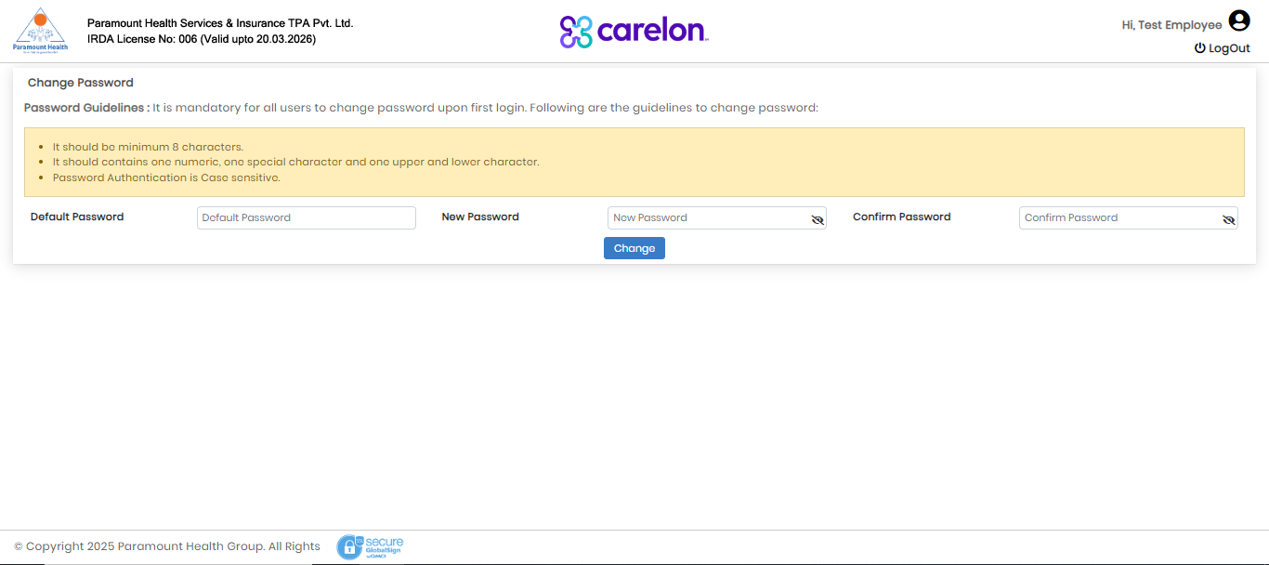
DEFAULT PASSWORD
DOB – DD/MM/YYYY
CHANGE TO A NEW PASSWORD
Change Password Screen

Slide 4
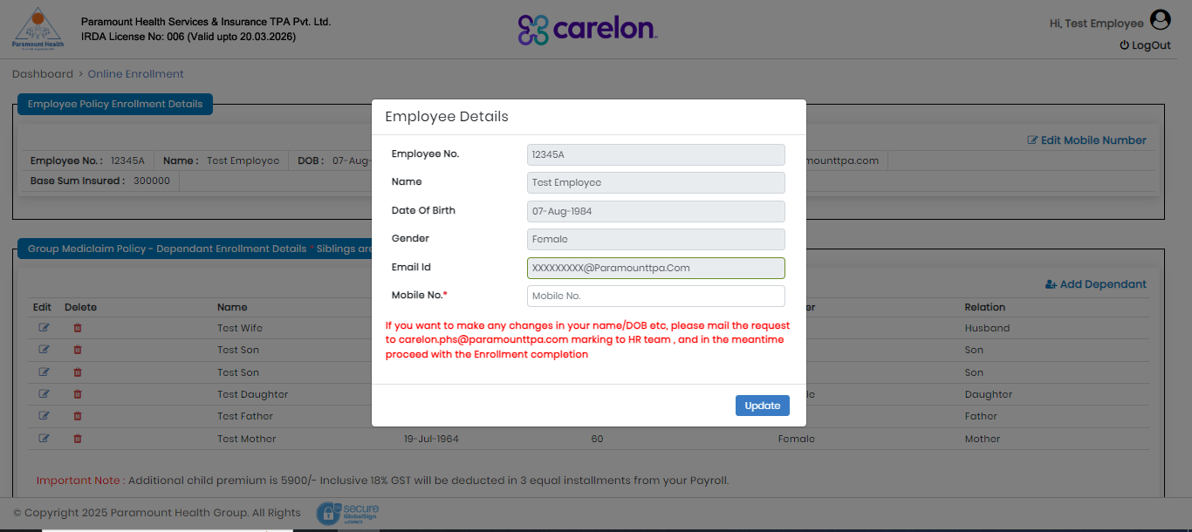
ONLY MOBILE NUMBER CAN BE EDITED. REST DATA CAN NOT BE CHANGED.
Employee Details Screen

Slide 5
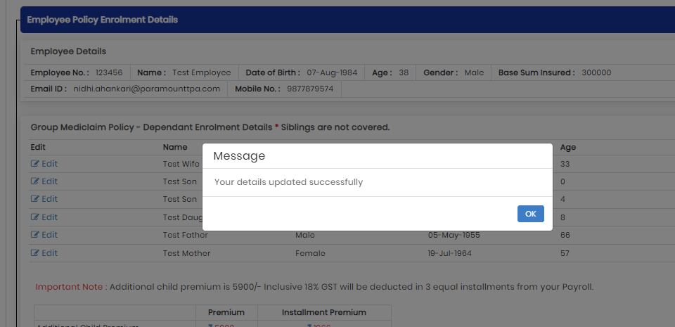
Details Update Screen

Slide 6
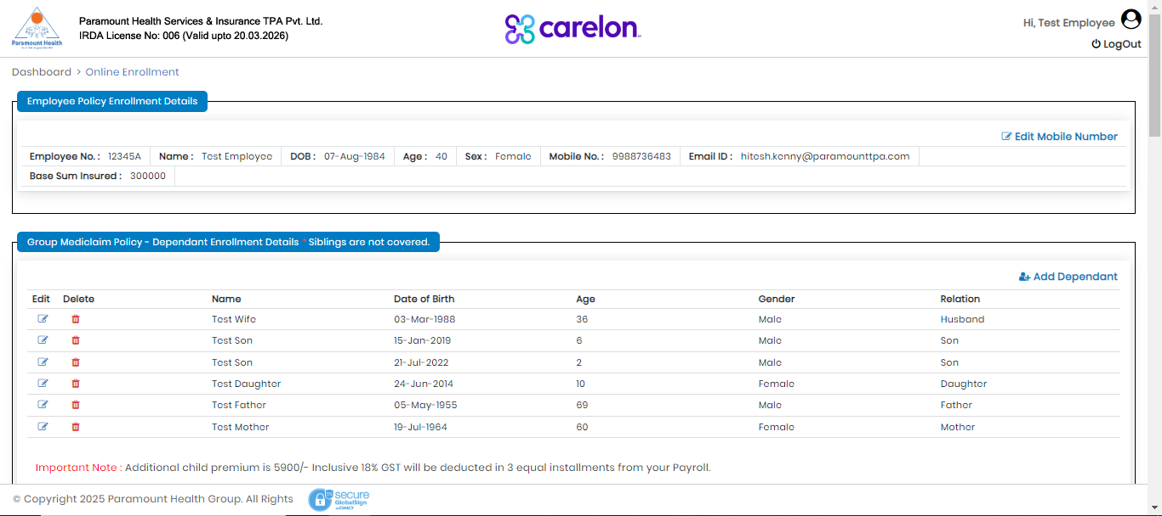
REVIEW / ADD DEPENDENT
Enrollment page - Dependent Details Screen

Slide 7
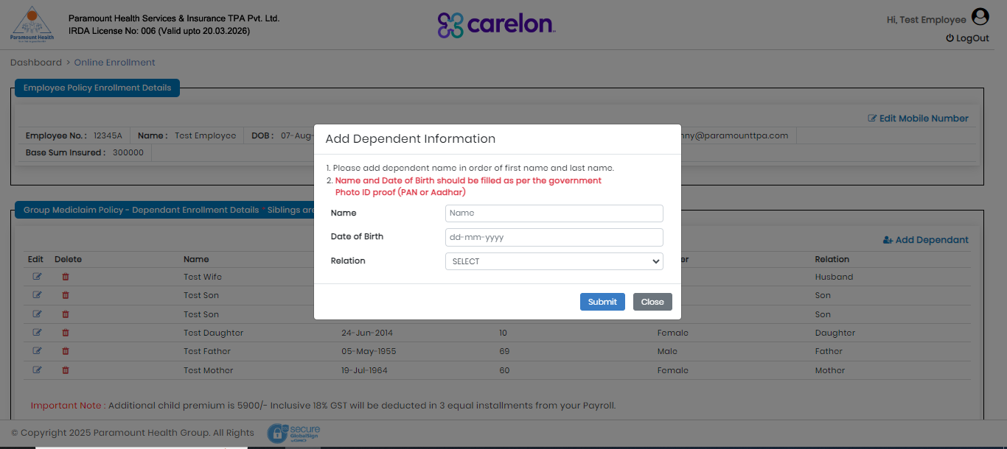
DEPENDENT NAME, DOB HAS TO BE AS PER THE GOVT ID CARD. CHECK THE RELATIONSHIP BEFORE SUBMITTING
Add Dependent Information Screen

Slide 8
Additional Premium for 3rd & 4th Child in the Policy
Additional Child Premium Screen

Slide 9
Additional Premium for 3rd & 4th Parent in the Policy
Adding Additional Parent (In-Laws) Screen

Slide 10
Additional Parent Premium
In-laws Parent Details Screen

Slide 11
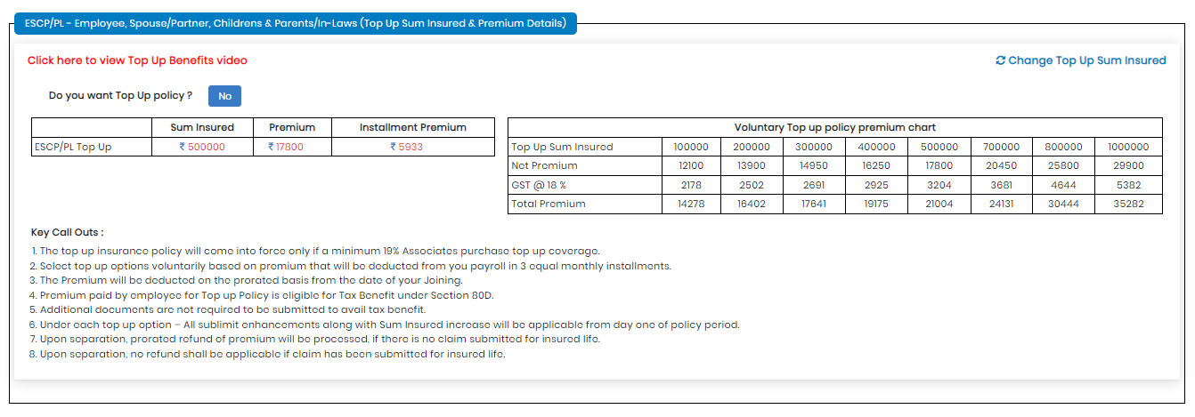
Opt for Top-Up Policy
Top-Up Premium Screen

Slide 12
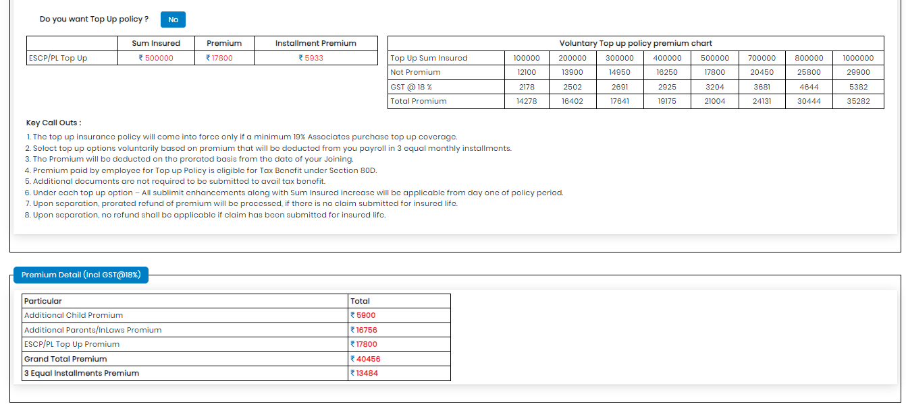
Total Premium
Total Premium Screen

Slide 13
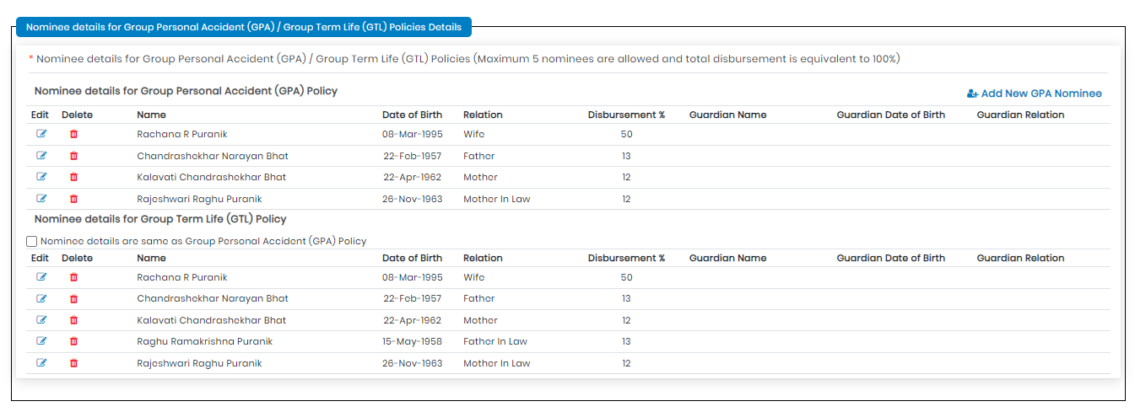
Nominee Declaration Page
Add Nominee Screen

Slide 14
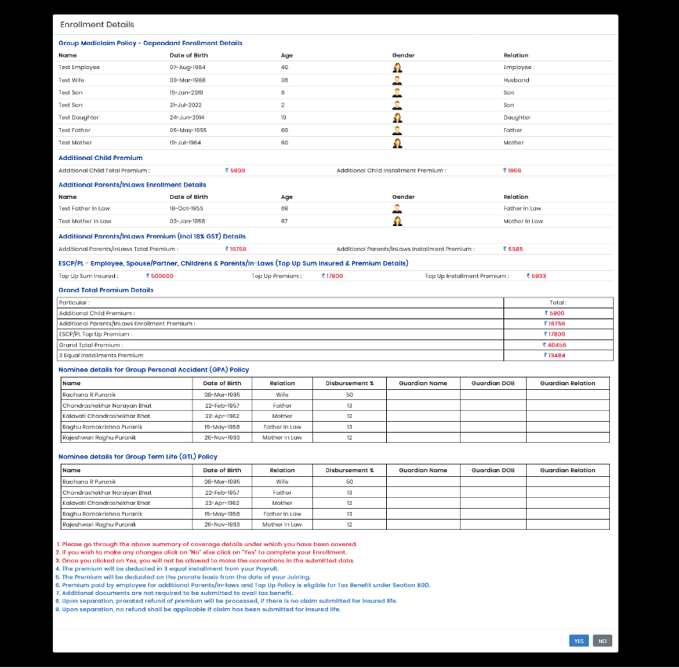
Confirmation
The Confirmed Details will be sent to the Registered Email of an Employee
Confirmation Screen

Slide 15
Enroll all your dependent/s details as per their GOVT ID PROOF
New born baby/newly married spouse can only be enrolled in mid year of policy within 30 days of event, existing member cannot be added.
Top up can be taken only during enrolment period.
Reimbursement Claim – Mandatory Documents
ABHI Claim form (Part A)
Valid NEFT document which has Name printed, A/c number and IFSC code mentioned (cancelled cheque /bank statement / passbook front page)
All hospitalization documents (do not miss out on any document provided by hospital)
Frequent Concerns Screen

Slide 16
Happy to Serve You

